Slide 1
Time Series Analysis
Basics of Time Series Analysis
Nicoleta Serban, Ph.D.
Associate Professor
Stewart School of Industrial and Systems Engineering
Decomposition: Trend Estimation

Slide 2
About this lesson

Slide 3
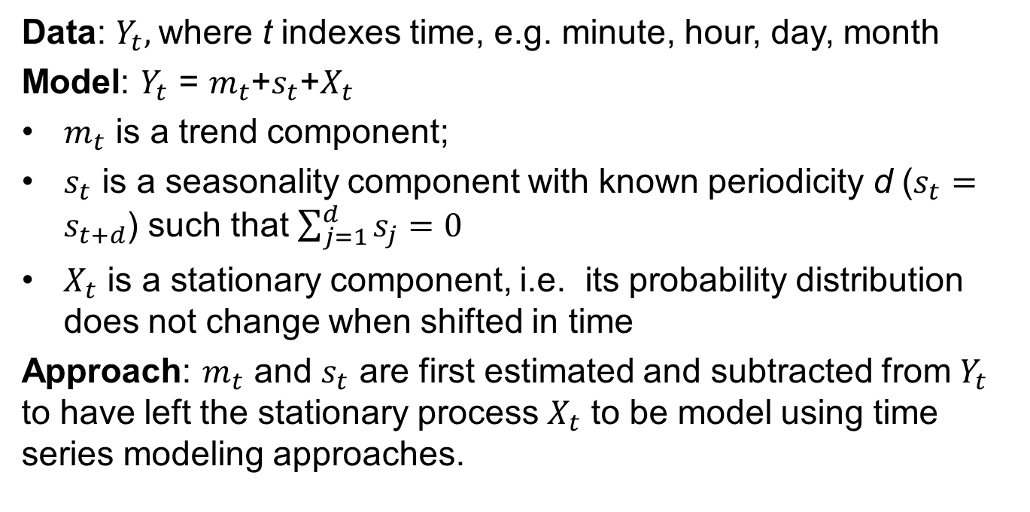
Time Series: Basics
Data: $Y_{t},$where t indexes time, e.g. minute, hour, day, month
Model: $Y_{t}$ = $m_{t}$+$s_{t}$+$X_{t}$
$m_{t}$ is a trend component;
$s_{t}$ is a seasonality component with known periodicity d ($s_{t}=s_{t+d}$) such that $\sum_{j=1}^{d}{s_{j}}=0$
$X_{t}$ is a stationary component, i.e. its probability distribution does not change when shifted in time
Approach: $m_{t}$ and $s_{t}$ are first estimated and subtracted from $Y_{t}$ to have left the stationary process $X_{t}$ to be model using time series modeling approaches.

Slide 4
Time Series: Basics
Data: $Y_{t},$where t indexes time, e.g. minute, hour, day, month
Model: $Y_{t}$ = $m_{t}$+$s_{t}$+$X_{t}$
$m_{t}$ is a trend component;
$s_{t}$ is a seasonality component with known periodicity d ($s_{t}=s_{t+d}$) such that $\sum_{j=1}^{d}{s_{j}}=0$
$X_{t}$ is a stationary component, i.e. its probability distribution does not change when shifted in time
Approach: $m_{t}$ and $s_{t}$ are first estimated and subtracted from $Y_{t}$ to have left the stationary process $X_{t}$ to be model using time series modeling approaches.

Slide 5
Time Series: Trend Estimation
Elimination of Trend (no Seasonality)
Estimate trend and remove it, or
Difference the data to remove the trend directly.
Estimation Methods
Moving Average
Parametric Regression (Linear, Quadratic, etc.)
Non-Parametric Regression

Slide 6
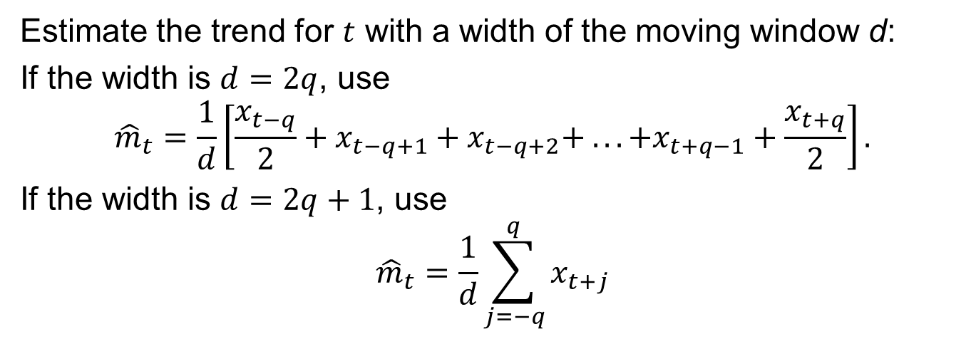
Trend: Moving Average
Estimate the trend for $t$ with a width of the moving window d:
If the width is $d=2q$, use
$${\hat{m}}_{t}=\frac{1}{d}\left[\frac{x_{t−q}}{2}+x_{t−q+1}+x_{t−q+2}+ .. . +x_{t+q−1}+\frac{x_{t+q}}{2}\right].$$
If the width is $d=2q+1$, use
$${\hat{m}}_{t}=\frac{1}{d}\sum_{j=−q}^{q}{x_{t+j}}$$
The width selection reflects the bias-variance trade-off:
If width large, then the trend is smooth (i.e. low variability)
If width small, then the trend is not smooth (i.e. low bias)

Slide 7
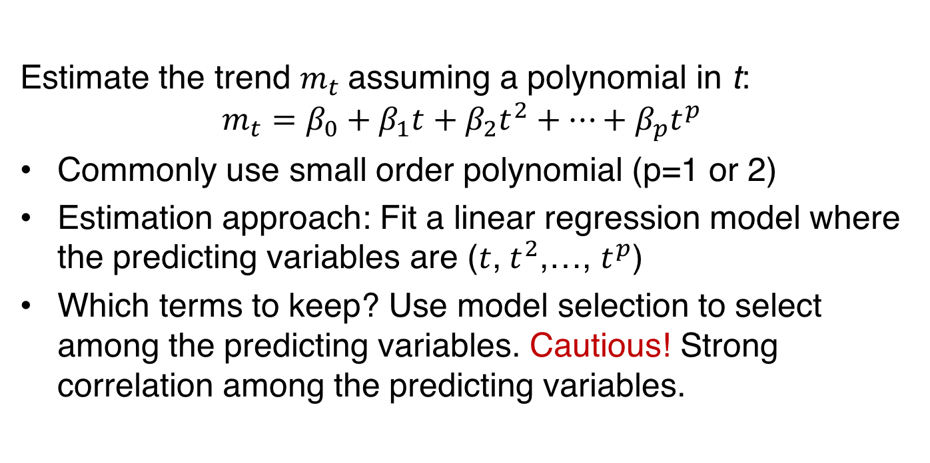
Trend: Parametric Regression
Estimate the trend $m_{t}$assuming a polynomial in t:
$$m_{t}=β_{0}+β_{1}t+β_{2}t^{2}+…+β_{p}t^{p}$$
Commonly use small order polynomial (p=1 or 2)
Estimation approach: Fit a linear regression model where the predicting variables are ($t$, $t^{2}$,…, $t^{p}$)
Which terms to keep? Use model selection to select among the predicting variables. Cautious! Strong correlation among the predicting variables.

Slide 8
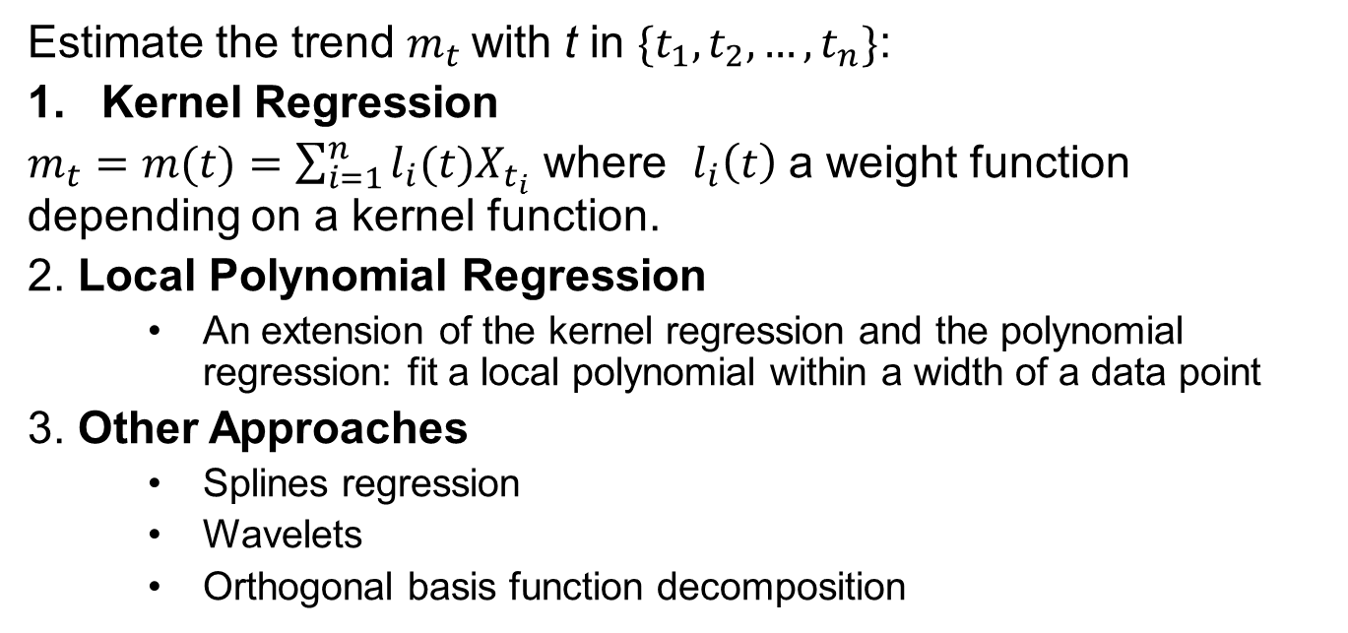
Trend: Non- Parametric Regression
Estimate the trend $m_{t}$with t in $\{t_{1},t_{2},…,t_{n}\}$:
Kernel Regression
$m_{t}=m(t)=\sum_{i=1}^{n}{l_{i}(t)X_{t_{i}}}$ where $l_{i}\left(t\right)$ a weight function depending on a kernel function.
2. Local Polynomial Regression
An extension of the kernel regression and the polynomial regression: fit a local polynomial within a width of a data point
3. Other Approaches
Splines regression
Wavelets
Orthogonal basis function decomposition

Slide 9
Trend: Non- Parametric Regression
Which one to choose?
Local polynomial regression is preferred over kernel regression since it overcomes boundary problems and its performance is not dependent on the design of the time points
Other methods are to be selected depending on the level of smoothness of the function to be estimated
For estimating the trend in time series, local polynomial or splines regression will perform well in most cases

Slide 10
Summary

